Slide 1
COMMUNICATION TECHNOLOGY QUIZ
BY,
Krithika, Isha, Disha, and Vaishnavi

Slide 2
RULES
This quiz consists of 6 questions.
You will be given 10 secs to answer each question.
Each question carries 5 points. Thus, this quiz is for 30 points.
There is no negative marking.
--- ALL THE BEST!!! ---

Slide 3
Question 1: Which company for the first time acquired 60 million subscribers within the first month of commercial operations?

Slide 4

Answer 1: Reliance Jio

Slide 5
Question 2: Tokyo Tsushin Kogyo is commonly known as______ .

Slide 6
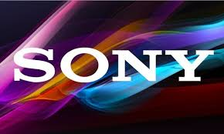
Answer 2: Sony

Slide 7
Question 3: Backup Rub is commonly known as ______.

Slide 8

Answer 3: Google

Slide 9
Question 4: Which video game is banned in Saudi Arabia as it had characters resembling The Cross and Star Of David?

Slide 10

Answer 4: Pokemon

Slide 11
Question 5: The company was found in 1901 in Japan. The company’s name was coined from two Kanji characters meaning Sun and Rise. Name the company.

Slide 12

Answer 5: Hitachi

Slide 13
Question 6: Which company is designing a bacteria free smartphone for hospital workers since 20%-30% of bacteria are transferred between a cellphone and a finger?

Slide 14

Answer 6: Blackberry

Slide 15
THANK YOU

